Slide 1
Review of Biclustering Methods

Slide 2
Concept of Biclustering
Biclustering:
Clustering of samples and genes simultaneously
Clustering of genes under subset of conditions
Clustering of samples with subset of genes
Look for local pattern
When to use Bicluster
Only small subset of genes participate in a cellular process
interesting cells are active under a subset of conditions
a single gene participates in multiple pathways

Slide 3
Concept of Biclustering
Characteristics of bicluster
A bicluster should be defined with respect to a subset of conditions
A bicluster should be defined with respect to a subset of genes
The bicluster should not be exclusive and exhaustive

Slide 4
Concept of Biclustering
Type of bicluster (Madeira et al. 2004)
Bicluster with constant values
Bicluster with constant on rows or columns
Bicluster with coherent values
Bicluster with coherent evolution

Slide 5
Clustering and Biclustering
Clustering
Cluster 1
Cluster 2
9
Notes:
5

Slide 6
Clustering and Biclustering
Biclustering
B1
B2
B3
B4
10
Notes:
6

Slide 7
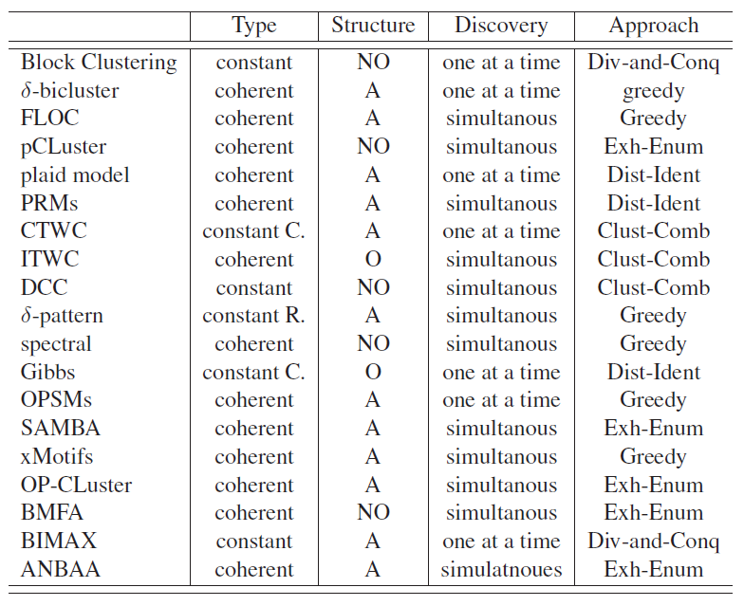

Slide 8
Our Focus (from: DAN and Suzy)
We only look at methods by coherent values and coherent evolution
My Preference
delta biclustering
FLOC (dealing with missing values)
SAMBA
BIMAX
xMOTIFS
Plaid Models
ITWC
BMFA

Slide 9
Overview of Methods
Preference
delta biclustering
delta biclustering modified by Kasim
FLOC (dealing with missing values)
SAMBA
BIMAX
xMOTIFS
Plaid Models
ITWC

Slide 10
Implementation
R biclust
BIMAX
Delta biclustering
Plaid model
Spectral
xMOTIFS
BMFA – matlab
Bicat (Barkow et al)
Syntren (den Bulcke et al.)
gcluto (Rasmussen et al.)
Expander (not free, Shamir et al.)

Slide 11
Examples
Biclustering approach to multi-compound screening
Note: This approach is similar to SAMBA , BIMAX and NBAA

Slide 12
Compounds Screening: mixture model
11
Notes:
12

Slide 13
Compounds Screening: mixture model
Three – components mixture model
12
Notes:
13

Slide 14
Compounds Screening: mixture model
Three – components mixture model
Inactive compounds
Active compounds
13
Notes:
14

Slide 15
Compounds Screening
Classification Matrix
14
Notes:
15

Slide 16
Compounds Screening
Classification Scores
Activity Score: number of cell line a compound is active upon
Response Score: number of compounds that are active on a cell line
15
Notes:
16

Slide 17
Application : Mixture model
Classification Matrix
NOTE: BIMAX can be applied on this matrix
16
Notes:
17

Slide 18
Application : Mixture model
Activity Plot
17
Notes:
18

Slide 19
Application : Mixture model
Activity Plot
C
A active on NONE
B
A
B active on SOME
C active on ALL
18
Notes:
19

Slide 20
Application : Mixture model
Cluster of Compounds
Selected Compounds
57 compounds
7 Responder Cell lines
8 Non-responder cell lines
Responders
Non-Responders
19

Slide 21
Application : Mixture model
20

Slide 22
Thank you

